Slide 1
Computer Architecture I Luai M. Malhis, PhD
Course covers:
Processor design and implementation
Memory Design and implementation
Text Book: Computer Organization and Design,
The Hardware/Software Interface by Hennessy and Patterson.
Course grading:
Midterm Exam : 30%
Homework Assignments: 20%
Final Exam : 50%,
1

Slide 2
Computer Components
All general-purpose computers require the following hardware components:
Memory: enables a computer to store, at least temporarily, data and programs.
Mass storage device: allows a computer to permanently retain large amounts of data. Common mass storage devices include disk drives and tape drives.
Input device : usually a keyboard and mouse, the input device is the conduit through which data and instructions enter a computer.
Output device : a display screen , printer , or other device that lets you see what the computer has accomplished.
Central processing unit (CPU): the heart of the computer, this is the component that actually executes instructions.

Slide 3
What is Computer Architecture?
The architecture of a processor is a description of its basic components and of its basic operations.
Computer architecture is a set of rules and methods that describe the functionality, organization, and implementation of computer systems
When we study computer architecture we analyze its:
Structure: static arrangement of the parts
Organization: dynamic interaction of the parts and their control
Implementation: design of specific components
Performance: analytical study of the system speed.
3
Notes:
3

Slide 4
Different processor architectures
Each processor family has its own architecture.
Assembly language is a programming view of the architecture of a particular processor.
Each type of processor has its own assembly language.
When you study an assembly language, you get an abstract view of the architecture of a particular processor.
Designing and implanting a processor is done in two steps
First, We must define the Instruction Set Architecture.
The ISA’s defines the functions and capabilities of the CPU.
Second, We define and implement the micro-architecture.
We study s the processor’s internal organization that defines
datapaths components, and how instructions are executed.

Slide 5
Instruction Set Architecture (ISA)
ISA is the interface between hardware and software
ISA is what is visible to the programmer (and ISA might be different for O.S. and Applications)
ISA consists of:
instructions (operations and how they are encoded (opcodes))
information units (size, how they are addressed etc.)
registers (or more generally processor state)
Addressing modes: literal, direct, register etc.
input-output control: interrupts
5
Notes:
5

Slide 6
Evolution of ISA’s
ISA’s have changed over computer “generations”.
A traditional way to look at ISA complexity encompasses:
Number of addresses per instruction (number of operands)
Regularity/size of instruction formats (data sizes and types)
Instruction Length and Format
Addressing modes ( literal, direct , indirect, relative, displacement)
6

Slide 7
The Different ISA’s Over the years many ISA’s have been proposed
Accumulator Based:
One operand is specified in the instruction (memory address
or constant). The other operand is implicit in the accumulator.
Stack Based: Zero operands are specified in the instruction. All operands are implicit on top of the stack.
Registers: All specified operands can be registers or constants.
No memory address specified in the instruction. (MIPS)
Register –Memory: At most on operand Can be a memory address.
other operands can be register or constant.
All Memory: operands can any combination of registers or memory
Even all three operands can be in memory (VAX)

Slide 8
Accumulator Architecture
One operand must be in the accumulator as source and destination
A = B+C
Load B
Add C
Store A
A = B/5 + C;
Load B
Div 5
Add C
Store A
8

Slide 9
Stack Architecture
All operands must be on the stack
A = B + C;
push B
push C
add
pop A
A = B/5 + C
push B
push 5
div
push C
add
pop A
*
9

Slide 10
Using Register Only (MIPS)
ALL Operands must be in Registers or at most one constant in an instruction
A= B+C
LOAD R1, B
LOAD R2, C
ADD R3,R1,R2
STORE R3,A
A = B + 5
LOAD R1,B
ADD R2,R1,5
STORE R2,A
10

Slide 11
Register-Memory and Memory-Memory
X86 one operand in memory
A = B+C
Mov AX, B
ADD AX,C
MOV A,AX
You Do A = B/5 - C
VAX ALL Operands in Memory
A =B+C
ADD A,B,C
You Do A = B/5 – C;
*
11

Slide 12
ISA’s classifications
Complex instruction set computers (CISC): 60’s and 70’s were very complex Necessary to reduce the number of instructions required to fit a program into memory.
However, also greatly increased the complexity of the
ISA as well. The Philosophy is build a complex processor
and keep small program size.
Reduce instruction Set Computers: The Goal is to reduce the complexity of the ISA while maintaining or increasing performance? The philosophy is large and we need to optimize the processor design to improve performance since and design simple instruction set. Program size is not an issue. Focus on simplify and fast execution.

Slide 13
CISC Design
Complex Instruction Set Computers were very complex
Necessary to reduce the number of instructions required to fit a program into memory.
However, also greatly increased the complexity of the ISA as well.
How do we reduce the complexity of the ISA while maintaining or increasing performance? Go to RISC
13

Slide 14


Reduced Instruction Set Computer (RISC)
John L. Hennessy
MIPS, 1981
Stanford
Simple pipelining, keep full
Influences: MIPS computer system, PlayStation, Nintendo
Dave Patterson
RISC Project, 1982
UC Berkeley
RISC-I: ½ transistors & 3x faster
Influences: Sun SPARC, namesake of industry
Notes:
Put picture of advisor and advisors advisor
14

Slide 15
Reduced Instruction Set Computer (RISC)
MIPS Design Principles
Simplicity favors regularity
32 bit instructions
Smaller is faster
Small register file
Make the common case fast
Include support for constants
Good design demands good compromises
Notes:
Need a segway
Make sure to define and discuss ISA and ARM
What happens when the common case is slow?
Can we add some complexity in the ISA for a speedup?

Slide 16
Reduced Instruction Set Computer
MIPS = Reduced Instruction Set Computer (RlSC)
small number of instructions are 32 bits each, 3 formats
all operands in registers
almost all are 32 bits each
Few addressing mode 3 to 4 : e.g Mem[reg + imm]
x86 = Complex Instruction Set Computer (ClSC)
Large number of instructions, 1 to 15 bytes each
operands in dedicated registers, general purpose registers, memory, on stack, …
can be 1, 2, 4, 8 bytes, signed or unsigned
10s of addressing modes
e.g. Mem[segment + reg + reg*scale + offset]
Notes:
DEC PDP-8 has about 8 insructions
16

Slide 17
Instruction Set Design
All the instructions executed by the CPU
User view of the Machine (Abstraction)
Describes machine layout and organization
The programmer’s view of the machine (Assembly)
Hardware dependent (Each has it own assembly)
Two types CISC and RISC
Design for the common case: Hardware/Softwarefaster
Smaller is always faster: register, cache, memory, disk
Technology and Cost plays a major Role
17

Slide 18
Addresses per instruction
RISC machines
Load-store and branches: 1 memory address + 1 or 2 registers
All other 3 registers or 2 registers + immediate
CISC machines
Most of them: Two addresses ( destination ← source op. destination)
One operand is a register; other is either register, immediate, or given by memory address
Some special instructions (string manipulation) can have two memory addresses
18

Slide 19
Regularity of instruction formats
Started with fixed format (ease of programming in “machine language”; few instructions)
Then more flexibility (assembler/compiler): three or four instruction formats, not necessarily the same length
Then strive for memory compactness. Complex, powerful, variable length instructions (x86)
Back to regular instruction sets: few formats, instructions of the same length (memory is cheap; instructions must be decoded fast)
19

Slide 20
Number of instruction formats
RISC: three or four (instructions have same length)
To Keep design simple and decoding fast.
CISC
Several formats, each of fixed (but maybe different) lengths. Decoding Slow.
Variable length instructions (depends on opcode, addressing of operands etc. Intel x86 instructions from (1 to 17 bytes) To keep program size small.
One instruction in CISC may requires executing many instructions in RISC.
Therefore same high level language program compiles to more machine instructions in RISC Compared to CISC.
20

Slide 21
Addressing modes
In early machines: immediate, direct, indirect
Then index + base (sum of 2 registers instead of -- or in addition to -- index +displacement)
All kinds of additional modes (indirect addressing, auto-increment, combinations of the above etc.)
In general RISC
Immediate, indexed, and sometimes index + base (IBM Power PC)
CISC
Complex addressing modes ( See VAX) machine next slide
21

Slide 22
A sample of VAX addressing modes
Immediate (with even some small f-p constants)
Direct (register) One instruction for each I-unit type
Indirect (deferred)
Autodecrement (and autoincrement) . The register is incremented by the I-unit type before (after) the operand is accessed
Displacement (like MIPS indexed)
Index like displacement but offset depends on the I-unit
Combination of the above and more
22

Slide 23
Examples
CLRL register (clears a whole register)
CLRB register (clears the low byte of the register)
CLRL (register) clears memory add whose add. is in reg.
CLRL (register)+ as above but then register is incr. by 4
CLRL @(register)+ as above with 1 more level of indirection (register points to address of address)
CLRL offset(register) Register + offset mult .by 4 for L, by 1 for B etc
CLRL offset[register] similar but use offset + 4 * register
CLRL 12(R4)+[R1] clear word at add. R4 + 12*4 + R1*4
then add 4 to R4
23

Slide 24
RISC Processor
MIPS family outgrowth of research at Stanford (Hennessy)
First RISC Architecture
Sun family outgrowth of research at Berkeley (Patterson)
IBM Power/PC family outgrowth of research at IBM
HP Precision architecture
Currently all new processor are based on RISC.
24

Slide 25
RISC vs. CISC
Complex instruction set computer (CISC):
Philosophy : Memory available is small optimize memory usage by reducing memory needed to store program.
Characteristics:
Large instruction set; Complex operations; Complex addressing modes;
Complex hardware, long execution time of a single instruction.
Minimum number of instructions needed for a given task;
Reduced instruction set computer (RISC):
Philosophy : Memory is large optimize instruction set and execution time.
Characteristics:
Small instruction set; Large number of registers;
Simple instructions to allow for fast execution (fewer steps);
Only read/write (load/store) instructions should access the main memory,
Simple addressing modes to allow for fast address computation;
Fixed-length instructions with few formats for fast instruction decoding;
simpler and faster hardware implementation, pipelined architecture.

Slide 26
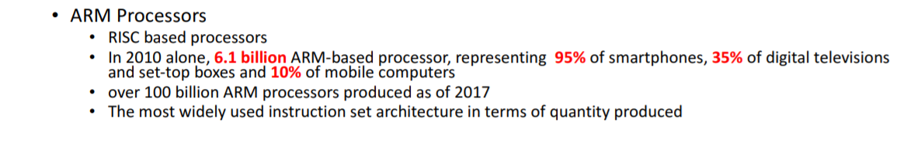
ARM Processor Vs X86 architecture RISC Architecture CISC Architecture Used in current mobile Used in the building PC devices based on IOS and based on mac (apple) and Android Operating systems windows operating systems
The x86 architectures were based on the Intel 8086 microprocessor chip, initially released in 1978. Intel Core 2 Duo – an example of an x86-compatible, 64-bit multicore processor. AMD Athlon (early version) – a technically different but fully compatible x86 implementation. Am386, released by AMD in 1991.The x86 architecture
Many millions of this processor architectures are produces each year for PCs
26

Slide 27

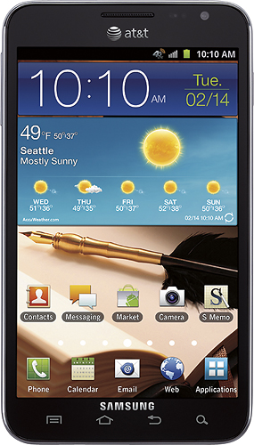
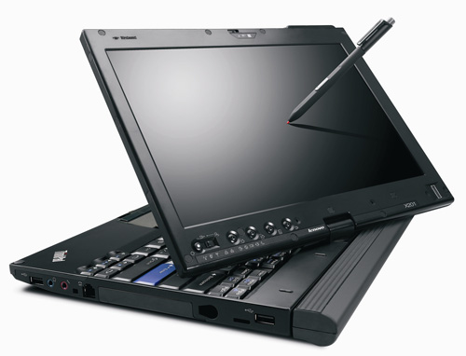
ARMDroid vs WinTel
Android OS on ARM processor
Windows OS on Intel (x86) processor
Notes:
In 2005, about 98% of the more than one billion mobile phones sold each year used at least one ARM processor.[5] As of 2009, ARM processors account for approximately 90% of all embedded 32-bit RISC processors[6] and are used extensively in consumer electronics, including personal digital assistants (PDAs), tablets, mobile phones, digital media and music players, hand-held game consoles, calculators and computer peripherals such as hard drives and routers.
27

Slide 28
Future Architecture is RISC V
RISC-V (pronounced "risk-five") is an open instruction set architecture (ISA) based on established reduced instruction set computing (RISC) principles. In contrast to most ISAs, the RISC-V ISA can be freely used for any purpose, permitting anyone to design, manufacture and sell RISC-V chips and software.
Many of the features of the RISC V architecture are similar to the mips architecture studying mips that we will study in details for the rest of the semester.
28

Slide 29
Computer structure: Von Neumann model
Data path
+
CPU
Control
Memory hierarchy
control
ALU
I/O
PC
Registers
state
Memory bus
I/O bus
29
Notes:
29

Slide 30
Some Computer families
Computers that have the same (or very similar) ISA
Compatibility of software between various implementations
IBM
704, 709, 70xx etc.. From 1955 till 1965
360, 370, 43xx, 33xx From 1965 to the present
Power PC
DEC
PDP-11, VAX From 1970 till 1985
Alpha (now Compaq, now HP) in 1990’s
30
Notes:
30

Slide 31
More computer families
Intel
Early micros 40xx in early 70’s
x86 (086,…,486, Pentium, Pentium Pro, Pentium 3, Pentium 4) from 1980 on
IA-64 (Itanium) in 2001
SUN
Sparc, Ultra Sparc 1985 on
MIPS-SGI
Mips 2000, 3000, 4400, 10000 from 1985 on
Today there are many more different computer families and architectures especially in the advent of mobile computing.
31
Notes:
31

Slide 32
Another important issue in ISA definition is Processor Memory Interface
The CPU interacts closely with primary storage, or main memory, referring to it for both instructions and data. Memory holds both program instructions and data at the time the computer is executing a program.
RAM provides the workspace within which a CPU works. Every location in RAM has a numbered address, and RAM is accessed strictly by that address.
How data is interpreted at each address depends if it is instruction or data and also on its Endianness (little endian or big endian).

Slide 33
Information units
Basic unit is the bit (has value 0 or 1)
Bits are grouped together in information units:
Byte = 8 bits
Word = 4 bytes
Double word = 2 words
etc.
33
Notes:
33

Slide 34
Memory addressing
Memory is an array of information units
Each unit has the same size
Each unit has its own address
Address of an unit and contents of the unit at that address are different
0
-123
1
17
2
0
contents
address
34
Notes:
34

Slide 35
Big Endian and Little Endian
To load word or store word instruction uses only one memory address. The lowest address of the four bytes is used for the address of a block of four contiguous bytes. (we address x we access x, x+1, x+2 and x+3)
How is a 32-bit pattern held in the four bytes of memory? There are 32 bits in the four bytes and 32 bits in the pattern, but a choice has to be made about which byte of memory gets what part of the pattern. There are two ways that computers commonly do this:
Big Endian Byte Order: The most significant byte (the "big end") of the data is placed at the byte with the lowest address. The rest of the data is placed in order in the next three bytes in memory.
Little Endian Byte Order: The least significant byte (the "little end") of the data is placed at the byte with the lowest address. The rest of the data is placed in order in the next three bytes in memory.
In these definitions, the data, a 32-bit pattern, is regarded as a 32-bit unsigned integer. The "most significant" byte is the one for the largest powers of two: 2³¹, ..., 2²⁴. The "least significant" byte is the one for the smallest powers of two: 2⁷, ..., 2⁰.
*
35

Slide 36
Big-endian vs. little endian
Byte order within a word:
3
2
1
0
Little-endian (we’ll use this)
0
1
2
3
Big-endian
36
Notes:
36

Slide 37
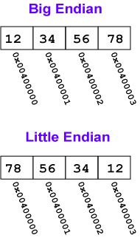
For example, say that the 32-bit pattern 0x12345678 is stored at address 0x00400000.
The most significant byte is 0x12;
The least significant is 0x78.
Within a byte the order of the bits is the same for all computers (no matter how the bytes themselves are arranged).
37

Slide 38
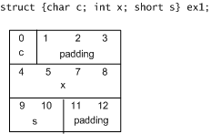
Memory alignment
means when storing data in memory place the data at a memory address divisible by its size without remainder.
Example:
if data size in 4 bytes (int) it must be stored at addresses: 0,4,8,12
if data size in 2 bytes (short) it must be stored at addresses: 0,2,4,6
if data size in 8 bytes (double) it must be stored at addresses: 0,8,16,24
if data size is 1 byte (char) if can be stored at any memory address.
38

Slide 39
Reason For memory Alignment
Improve system's performance due to the way the CPU handles memory. Most CPUs can access only memory aligned addresses.
Each time we access group of 4 bytes.
0,1,2,3 first group
4,5,6,7 second group and
8,9,10,11 third group.
Aliment is necessary to reduce the number of times we need to go to memory to get data. If aligned to read a word I go to memory once 0,1,2,3 If not aligned word is stored 5,6,7,8 I will nee to go to memory twice and getting data takes even longer for doubles. If short is stored at 7,8 then we need to go to memory twice because once for G1, 4,5,6,7 to get byte 7 and and another access G2 8,9,10,11 to get bytes 8.

Slide 40
Studying Computer Architecture Benefits :
Hardware point of view: It Deals with the components and their connection in a system. Computer Architecture helps us to understand the functionalities of a system. It tells us how exactly all the units in the system are arranged and interconnected. It gives us knowledge to design, develop, and implement new processors.
Software Point view:
It explores how machines are designed, built, and operate. Knowing what's inside and how it works will help us design, develop, and implement applications better, faster, cheaper, more efficient, and easier to use because we know how the machine works.

